Slide 1
By Temtim Assefa
Chapter 7
Qualitative Research Method
(4 Periods)

Slide 2
Objective the chapter
Students able
Explain the qualitative research approach
Understand the process of conducting qualitative research
Explain the different data collection methods for qualitative research
Describe the different data analysis methods in qualitative research
Differentiate qualitative research from other research approach
Evaluate the strength and weakness of qualitative research approach

Slide 3
Qualitative Research Methods
Qualitative research is undertaken under interpretivist research paradigm
It constructs knowledge through inductive process of knowledge construction .
It intends to understand some aspect of social life, and it uses words, rather than numbers, as data for analysis.
Constructs knowledge from peoples claims or people’s understanding of their phenomena
Ask students to give examples?

Slide 4
Features of Qualitative Research
Research enables a holistic perspective –
the complex phenomena cannot be reduced to several variables and linear casual relationships
Research incorporates an emergent designs
Understanding develops and evolves through the research process
Data collection and analysis undertaken iteratively
Research is descriptive
Descriptions includes a detailed account of the context, the activities, the participants and the processes

Slide 5
Features of Qualitative Research …
Research is concerned with process rather than outcomes or products
Interested in understanding and describing dynamic and complex processes
Concerned with what, why and how questions
What was the SW development process
How was the SW developed

Slide 6
Qualitative Research …
Research involves field work
The researcher has direct contact with the people involved in the phenomena or the natural settings of the phenomena
Uses the researcher as the primary instrument for data collection and data analysis
Interested in how people make sense of their lives, how they interpret experiences and how they structure their social world
Tries to build a shared understanding among stakeholders

Slide 7
Conditions to Choose Qualitative Research
When the research problem is not clear at the beginning of the research
As the researcher gets increasing understanding of the phenomena, he/she can formulate specific research questions
No clear understanding to choose the method.
The methodology (whether case study, ground theory, ethnographic, etc ) is decided over the course of investigation
When the interest is to generate rich description of the phenomena from multiple perspectives

Slide 8
Conditions to Choose Qualitative Research
When samples are small and not necessarily representative of the broader population
the findings lack rigour;
Generating hypotheses that can then be tested by quantitative methods.
Intending to answer questions about the ‘what’, ‘how’ or ‘why’ of a phenomenon
rather than ‘how many’ or ‘how much’, which are answered by quantitative methods.
Read this article to get better understanding - https://www.alnap.org/system/files/content/resource/files/main/qualitative-research-methodology.pdf

Slide 9
Deliverables of Qualitative research
Description of the phenomena
Theory, framework, a model
Develop new concepts or theoretical perspectives about the phenomena
Verification on existing claims, assumptions and theories
Evaluation – to evaluate the effectiveness of a particular policies, software artifacts, programs, etc

Slide 10
What is the strong side of the qualitative research from your perspective?

Slide 11
Type of Qualitative Research methods
case study
action research
grounded theory
historical research
etc

Slide 12
Case study research
Investigates a contemporary phenomenon within its real-life context, especially when
The boundaries between phenomenon and context are not clearly evident.
Case studies focus on understanding the dynamics present within a single setting (Eisenhardt, 1989).
Conducted on single or multiple cases
Intended to answer how and why research questions
Use multiple methods of data collection
Generate thick descriptions about the case

Slide 13
Types of Case studies
Descriptive: Generates thick description about the case being studied. For example it is used to describe a new information system implementation and the context in which it occurred.
Exploratory: explores new insights about less known phenomenon. Mainly used to develop theory or hypothesis
Explanatory: explain causal links in interventions; link software implementation with software effects.

Slide 14
Action Research
Commonly used in IS research
teacher-initiated, school-based research used to improve the practitioner’s practice by doing or changing something
Main Phases to do action research
Identify problem,
propose solution,
implement solution and
collect data about your solution (how it is effective)
Revise if problem is not solved

Slide 15
Generic Research Design
Define problem
Conceptual framework/
proposition
Review of literature
Data collection Methods and instruments
Sampling
Data Collection
Data Analysis
Build Theory
Or Framework
Report writing

Slide 16
Qualitative Data Collection methods
Qualitative data collection is referred to as fieldwork.
Fieldwork includes materials gathered, recorded, and compiled during the study.
Fieldwork requires the researcher to immerse himself in the setting over time.
The researcher collects as much data she/he can as unobtrusively as possible.
Qualitative data is narrative and visual.
See this site for additional reference - https://www.slideserve.com/gali/chapter-14-qualitative-data-collection

Slide 17
3. Data collection...
primary data collection methods include
Interviews
observations
Personal and official documents, photographs, recordings, drawings, emails, and informal conversations
Use of multiple data sources are normative

Slide 18
Interview
Interviews resemble everyday conversations,
But interview in research must focus on the researcher’s needs for data.
It must be conducted in the most rigorous way to ensure reliability and validity (i.e. ‘trustworthiness’).
Data collection through interview must be guided by interview check list
The interview check list can be designed as unstructured or semi structured interview check list

Slide 19
Interview
Unstructured interview
What do you think about the success of the newly implemented software?
What do you think about factors that contribute to the success of the software?
Semi structured interview
How much contribute the new software to the organizations profit?
How much time is saved by the new software?
How do users use the new software?

Slide 20
Conducting interview
Listening is the most important part of interviewing.
Don’t interrupt. Wait.
Tolerate silence.
Avoid leading questions.
Keep participants focused and ask for details.
Follow-up on what participants say and ask questions when you don’t understand.
Don’t be judgmental about participants’ views or beliefs.
Don’t debate with participants.
Use digital voice recorder

Slide 21
Interviewees …
Reproducible: someone else could use the same topic guide to generate similar information;
Systematic: to ensure that we are not just picking interviewees or data that support our pre-existing ideas about the answers;
Credible: the questions we ask, for instance, and the ways in which we ask them should be reasonable ones for generating valid (or ‘truthful’) accounts of phenomena.
Transparent: methods should be written up so that readers can see exactly how the data were collected and analysed.

Slide 22
Observation
The researcher obtains data by watching participants.
Observational data is often less subject to participant bias.
The researcher attempts not to change the setting.
Observation can be conducted using observation checklist or without a check list
Use digital camera to record some important process and objects

Slide 23
Observation …
Forms of observation
Participant observation
The researcher becomes part of and a participant in the situation being observed.
The researcher participates while observing and collecting data
Nonparticipant observation •
The researcher is not directly part of the situation being observed.
The researcher observes and records but does not interact with the participants.
Nonparticipant observation is a less intrusive/disturbing form of observation.

Slide 24
Data collection Instrument Design
Identify type of information needed to answer your RQs
Create a matrix that aligns your research questions with the type of information you need and the methods that you will use to collect data
Four areas of information are typically needed for most qualitative studies as an example : contextual, perceptual, demographic, and theoretical

Slide 26
Instrument Design
Constructing a matrix that lists the research questions along the column and the interview questions along the rows help to capture all necessary data to your research questions.

Slide 27
Cont’d …

Slide 28
Sampling
Samples in qualitative research are usually purposive.
Participants are selected because they are likely to generate useful data for the research
To ensure good coverage of sample, use maximum variation sampling strategy
This involves selecting key demographic variables that are likely to have an impact on participants’ view of the topic.
create a sampling ‘grid’ and recruit groups that reflect various combinations of variables. For example: age (adolescents, adults, elderly); male/female; low income/high income; rural/urban; ethnicity.
Sampling strategies should therefore always be determined by the purpose of the research project

Slide 29
Sample size
There is no criteria to set sample size
One method is theoretical saturation
Keep interviewing until, in analysis, nothing new comes from the data
A more practical method for short term studies is to estimate this point as around 15 people for any homogeneous group (which could be based on age, gender, skill, etc).
Use stratified method so as to get good representation if the population is heterogeneous

Slide 30
Qualitative Data Analysis

Slide 31
Qualitative Data Analysis
Qualitative Data Analysis (QDA) is the range of processes and procedures to reduce bulk data
In short qualitative data analysis is Data Reduction
How? Very difficult to articulate
The idea is to examine the meaningful and symbolic content of qualitative data.
In general, the intent is to make sense out of collected data
Generally referred as Thematic Analysis
Providing “Thick” description is important

Slide 32
Cont’d …
For example, by analyzing interview data the researcher may be attempting to identify any or all of:
Someone's interpretation of the world,
Why they have that point of view,
How they came to that view,
What they have been doing,
How they conveyed their view of their situation,
How they identify or classify themselves and others in what they say,

Slide 33
Approaches in Qualitative Data Analysis
Deductive Approach
Using your research questions to group the data and then look for similarities and differences.
Used when time and resources are limited.
Used when qualitative research is a smaller component of a larger quantitative study
Inductive Approach
Used when qualitative research is a major design of the inquiry.
Using emergent framework to group the data and then look for relationships.

Slide 34
Inductive Approach: Four steps of data analysis
Familiarization
Transcription
Organisation
Inductive Analysis
Grounded
theory
Report Writing
Coding
Deductive Analysis
Framework
analysis

Slide 35

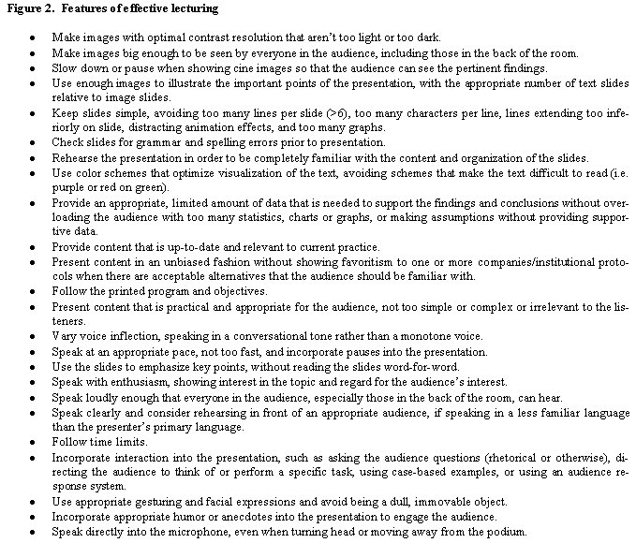

Analysis - Transcription
Field notes
Transcript
Interview
Transcription is the process of converting audio recorded data or handwritten field notes obtained from interviews and observations into verbatim form (i.e. written or printed) for easy reading

Slide 36
Organization
After transcription, it is necessary to organise your data into sections that is easy to retrieve.
Remove personal names and use codes to refer to the original transcribed document
Determine how analyze the data - word level, sentence level, paragraph level and they have to be numbered accordingly.
Make sure that the unit of text you use can be traced back to its original context.
For example, one teacher described his principal as a person who “walks the factory floor”. Able Trace who said so

Slide 37
Analysis – Coding
Coding is the process of examining the raw qualitative data in the transcripts and extracting sections of text units (words, phrases, sentences or paragraphs) and assigning different codes or labels
It is the process of assigning labels to words or phrases that represent important (and recurring) themes in each response.
Use words or short phrases as labels, since they’re easier to remember, skim, and organize.
Codes can be based on:
Themes, Topics
Ideas, Concepts
Terms, Phrases
Keywords

Slide 38
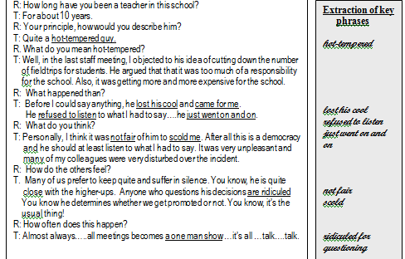
Example of Coding

Slide 39
More Example
Extracts of interview data
1. my baby was very hot with a fever in the morning
2. he cried and cried
3. my mother in law said to put a flannel on his head
4. but he was so hot I knew it was not right
5. and I told my husband to hurry to get him to the clinic
What is the possible code ?
We could just see this as an example of the theme ‘coping with fever’,
but we will get more out of the data if we think in detail about the various different things that are going on here, such as: sources of information and advice; remedies; triggers to health care seeking.

Slide 40
Theme Development
After coding an entire text, make a list of all the code words.
Group similar codes and look for redundancy codes
Take the list and go back to the data. Circle specific quotes from participants that support the codes
Reduce the list of codes to get five to seven themes/categories

Slide 41
Themes
Like codes, themes have labels. Types:
Ordinary themes – themes that a researcher might expect to find
Unexpected themes – themes that are surprises
Hard-to-classify themes – themes that contain ideas that do not easily fit into one theme or that overlap
Major and minor themes – themes that represent the major ideas and the minor secondary ideas

Slide 42
Summarizing your Data
After you have coded a set of data, write a summary of what you are learning.
Similarly, summarize the key themes that emerge.
With your data coded and summarized you are ready to look across the various summaries and synthesize your findings across multiple data sources.

Slide 43
RQ: Why do students have problems with critical thinking?
Major and Minor Themes from Teacher s’ Interview
Question What are some of the challenges that your students face in developing their critical thinking skills? | Major Theme Reading Challenges | Minor Theme Time constraints
How do you help to enhance the critical thinking skills of your students? | Need authentic learning experience | Greater immersion in reading
What supplementary materials do you encourage your students to read within the subject area? | Need to Read newspapers | Reading of Journals

Slide 44
Collating Data into a Table of Coded Responses
Interview
(teachers)
Reading challenges
Need to read newspaper
Observation
(students)
Unwilling to work in group
Tardiness
Questionnaire
(students)
Lack of group cohesion
Request teacher’s assistance too frequently
Need authentic learning experience
Laziness and fatigue
Limited independent thinking

Slide 45
Additional Tips on Organization of Codes and Themes

Slide 46
Explanation of Themes
Write up and explain the themes in narrative format under the specific research question
Use a few actual quotes from the participants responses to validate your narrative (3 -5 is enough)
Do this for each major theme that emerged from the data

Slide 47
Example of Narrative Format
RQ: Why do students have problem with critical thinking?
Reading challenges. When asked what are the challenges that students face in developing critical thinking skills the teachers interviewed felt that students had reading challenges. Many students were reading below their grade levels with limited vocabulary. This made it difficult for students to decipher the meaning of written work.
The following are some direct quotation from the participants:
[1] “Students do not read on their own. Hence they cannot think critically when given the opportunity”.
[2] “Their reading level”.
[3] “They are unable to decipher the meaning of some key terms used in the question”.

Slide 48
Analysis – Framework Analysis – Deductive
This approach to qualitative data analysis allows the researcher to set the categories and themes from the beginning of the study.
Also allows for categories and themes that may emerge during data analysis
Assign specific pieces of data to the different themes or categories.
Let us take an example from medicine. You may want to know, for instance, about how people who had had a heart attack conceptualise the causes of the attack. From existing literature, you may know that these can be divided into physical causes, psychological causes, ideas of luck, genetic inheritance and so forth. You interview people who have had a heart attack and from the interview transcript you search the data for material that could be coded under these headings.

Slide 49
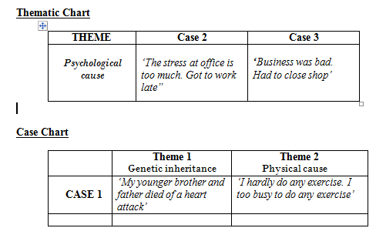
Analysis – Framework Analysis

Slide 50
Application of Qualitative - Example
System Development Research Process that Nunamaker, et al (1991) proposed five stages or activities
construct a conceptual framework,
develop a system architecture,
analyze and design the system,
build the (prototype) system, and
observe and evaluate the system.
The last stage explicitly includes “Develop new artifacts based on the observation and experimentation of the system’s usage”

Slide 51
Common Qualitative Software
QSR Nvivo (www.qsrinternational.com)
Atlas ti 6.0 (www.atlasti.com)
Hyper RESEARCH 2.8 (www.researchware.com)
Max QDA (www.maxqda.com)
The Ethnography 5.08
QSR N6 (www.qsrinternational.com)
Weft QDA (www.pressure.to/qda)
Open code 4.0 (www8.umu.se)

Slide 52
Reference
Singh, K. (2007). Quantitative Social Research Methods, Chapter three: Research process
Orlikowski, W. and Baroudi, J. J. (1991). Studying Information Technology in Organizations: Research Approaches and Assumptions

Slide 53
Review questions
When do you use qualitative research methods?
What is the strength of qualitative research methods?
What are the data collection methods?
How do you analyze data in qualitative research method?
What is the main limitation of qualitative research?

Slide 54
End!

